Slide 1




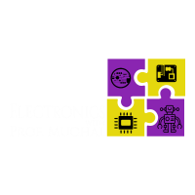

ATM Machine using fpga board
By: Prof. Mughal
#electronicswithprofmughal

Slide 2
outline
PROJECT FEATURES
DEMO
FUNCTIONAL BLOCK DIAGRAM – RTL SCHEMATIC
CODING
IMPLEMENTATION ONTO AN FPGA BOARD

Slide 3
Project features
ATM machine to deposit / withdraw money from an account.
Displays the current balance on the seven segment.
Use switches on the board to determine what type of dollar bill you would deposit / withdraw from the account.
Switch 0 = $1
Switch 1 = $5
Switch 2 = $10
Switch 3 = $20
Switch 4 = $50
Switch 5 = $100
Buttons can be used to deposit (RT)/ withdraw (LB) money into the account.

Slide 4
Project features, Contd.
We’ll use an 8-bit counter for simplicity, the maximum amount you can deposit into the account is $255.
Leds indicate following:
Led[0] – Max. deposit amount has reached
Led[1] – Ensures that only one switch is selected at a time ($1, $5, etc.)
Led[2] – Can’t go below this amount
Center button to reset the ATM Machine.

Slide 5
DEMO TIME

